Slide 1
Smart Newton Car
By: Hui Zhu

Slide 2
Miss Zhu
www.kidsrobotics.ca

Slide 3
WHAT IS A ROBOT?
A robot is a combination of electronics, mechanics and programming, which senses it's surrounding environment through its sensors; processes the sensor information and does something in response.

Slide 4
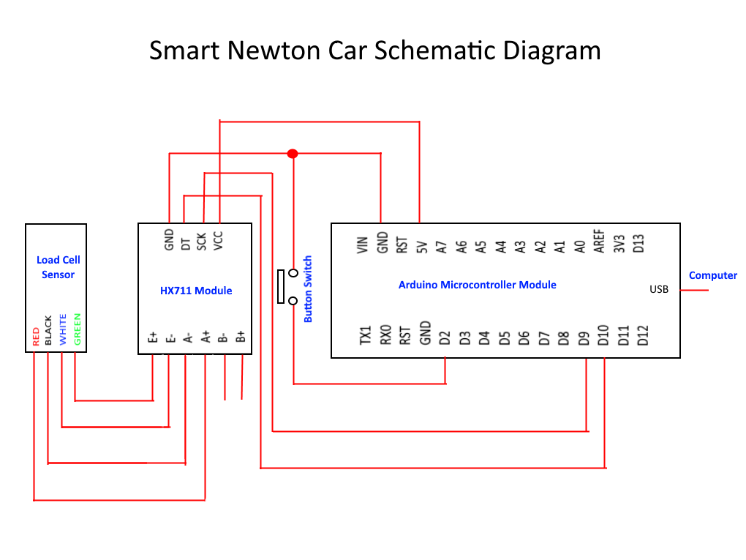

Slide 5
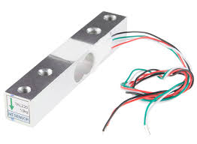
Load Cell (force sensor)
when force is applied to a load cell, it deforms, and causes the electrical resistance to change.

Slide 6
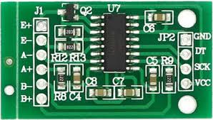
HX711 Module
Amplify the voltage from mill volt to volt.
Convert the analog signal to a digital signal.

Slide 7
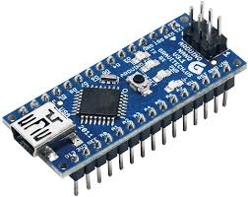
Arduino Microcontroller
The microcontroller is the brain of the robot. It processes data and display data in the computer.
Arduino is an open source.

Slide 8
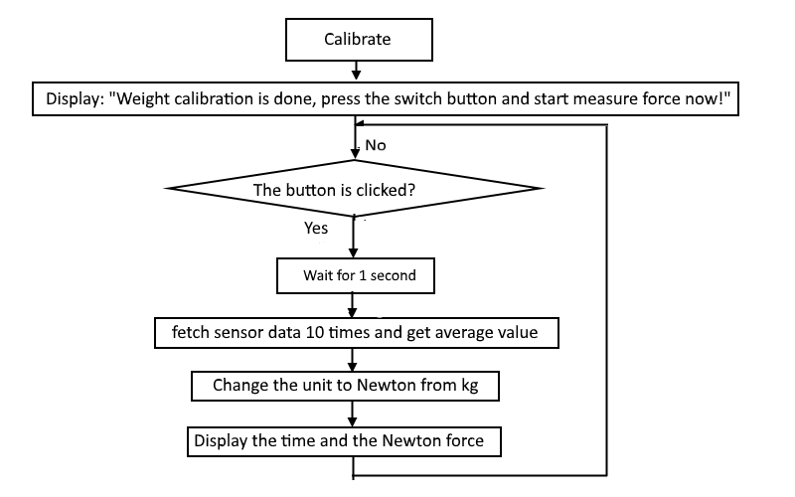
Smart Newton Car Software Flow Chart

Slide 9
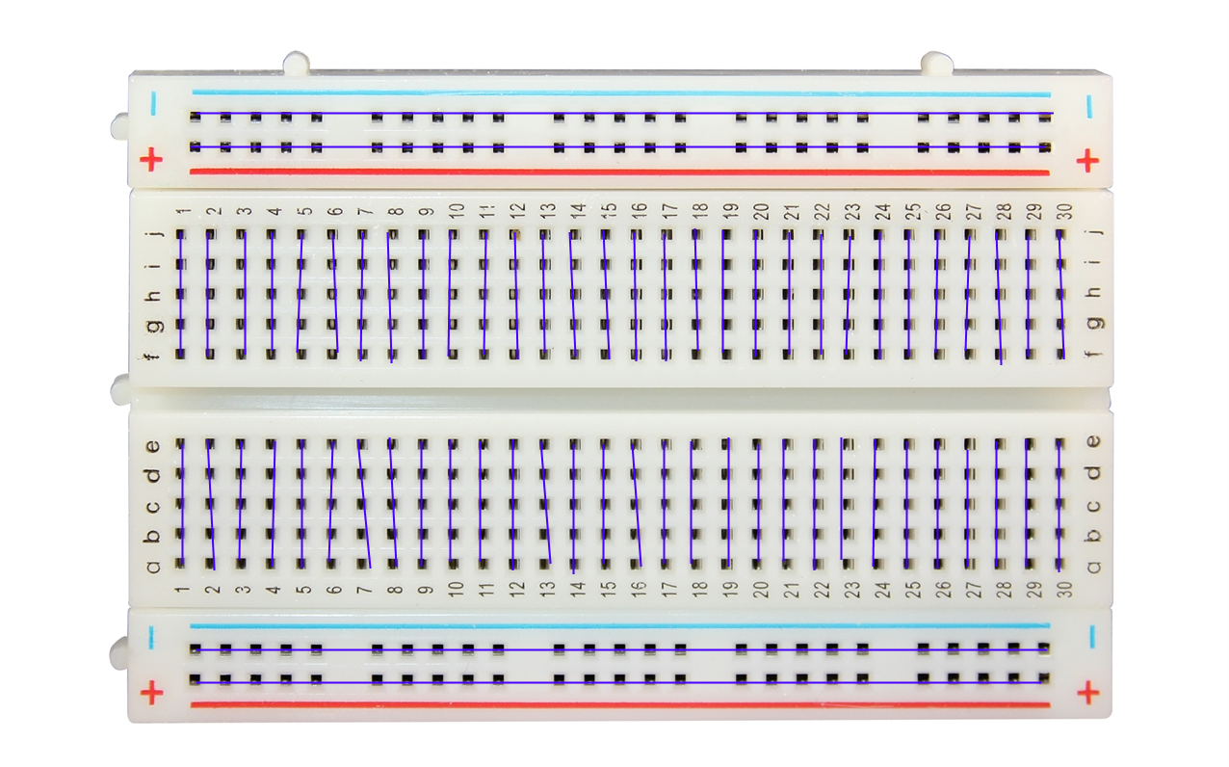
Breadboard
It's a fantastic tool for people who want to connecting wires without needing to solder them.

Slide 10
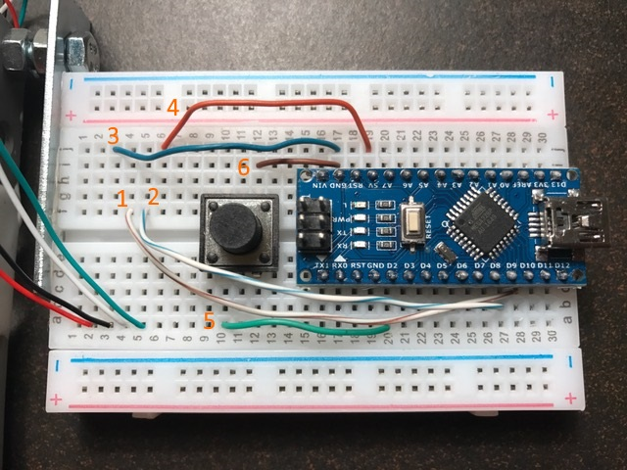
Assemble the Smart Newton Car
1. F4 to C28
2. F5 to B27
3. J3 to J17
4. J6 to J19
5. A10 to A20
6. I12 to I17

Slide 11
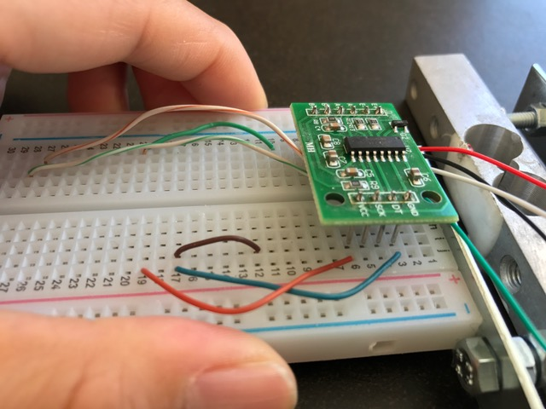
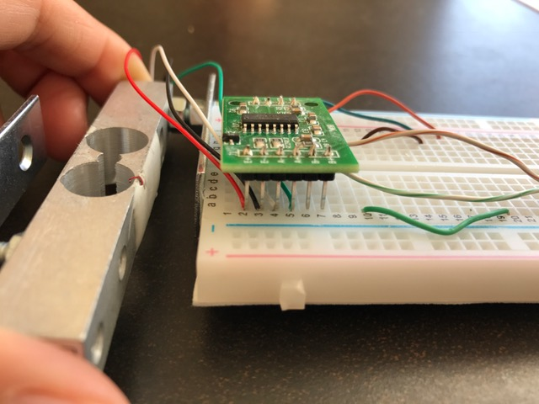
Plug HX711 module in the breadboard

Slide 12
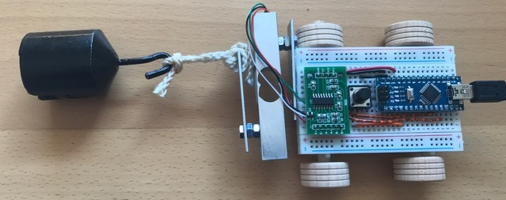
Smart Newton Car

Slide 13
Using Arduino IDE
Go to “codebender.cc/static/plugin” ----- Download Arduino IDE plugin
Go to “edu.codebender.cc” ----- Open Arduino IDE to show display result

Slide 14
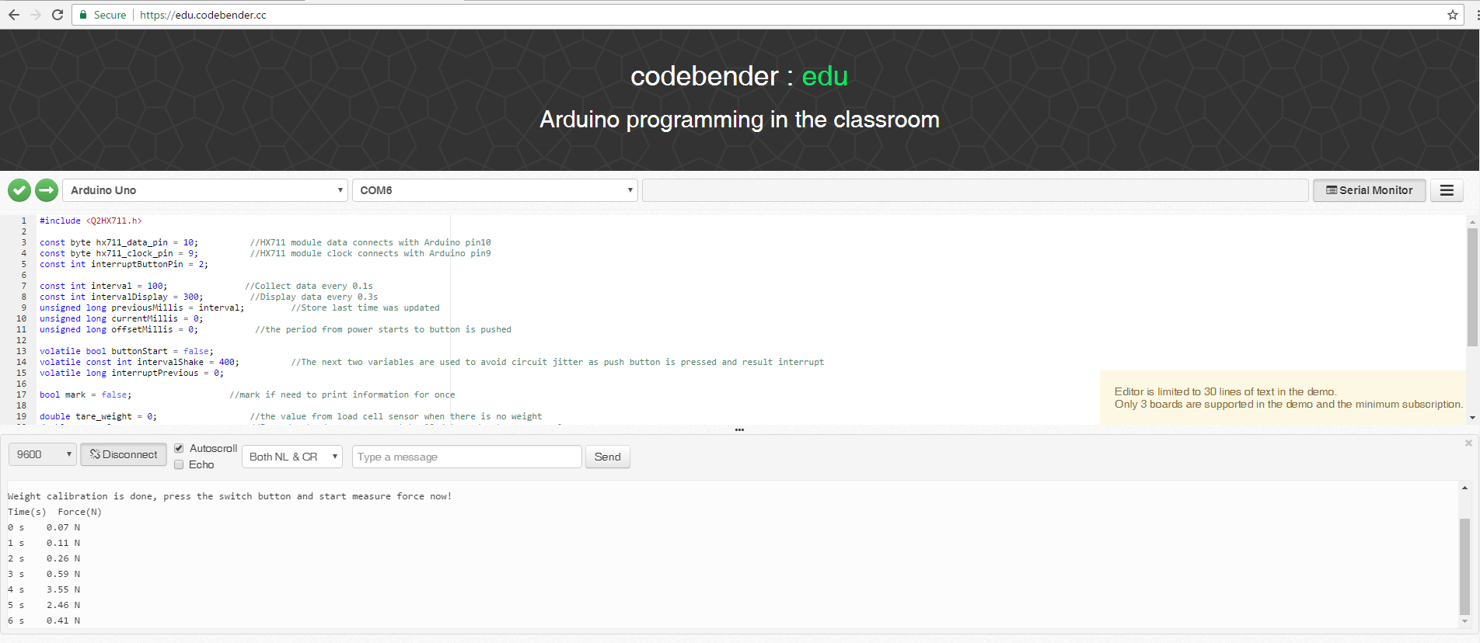

Slide 15
How to Save Display Result to Google Sheets
Put your mouse in the serial monitor of Arduino IDE and click.
Right click and select display result
Right click and select ‘Copy’
Open Google Sheets
Click the first column
Right click and select ‘Paste’
Adjust one column to two columns (time & force)
Click "Save As" in the Google Sheets and type a name

Slide 16

Thank You ! www.kidsrobotics.ca
If you have any
question, ask Miss Zhu.

